Slide 1

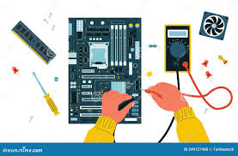
HARDWARE TROUBLESHOOTING AND PREVENTIVE MAINTENANCE
UNIT
5

Slide 2
Learning Outcomes
At the end of this unit, students will be able to:
Explain maintenance procedures and troubleshooting
State hardware problems
Describe hardware preventive maintenance
Perform basic hardware troubleshooting & preventive maintenance
Recognize the value of hardware troubleshooting to keep computer safety

Slide 3
5.1. Hardware Troubleshooting
Hardware troubleshooting is a systematic approach to locating the cause of a fault in a computer system and solving technical problems.
It starts with general issues and then gets more specific.

Slide 4
5.1.1 Hardware Troubleshooting Procedures
Hardware troubleshooting is the process of reviewing, diagnosing, and identifying operational or technical problems within a hardware device or equipment.
Software troubleshooting is the process of scanning, identifying, diagnosing, and resolving problems, errors, and bugs in software.

Slide 5
Cont…
Many computer problems can be solved by checking the following simple hardware problems:
Check that your computer is plugged into a working power outlet.
Check that everything is turned on.
If the computer is on but the screen is blank, there may be an issue with the connection between the computer and the screen.

Slide 6
Cont…
First, check to see if the monitor is plugged into a power outlet and if the connection between the monitor and computer system unit is connected securely.
Check that the keyboard, mouse, monitor, speakers, etc. are properly plugged into the computer system.
Try a different port to check if it is a port issue, or change the device if the device is damaged.

Slide 7
Cont…
Notes
It is necessary to switch off the computer before undertaking any hardware maintenance such as removing or replacing computer parts.

Slide 8
5.1.2 Check POST
POST stands for Power On Self-Test.
This is part of a computer’s startup program that is used to diagnose the keyboard, the Random Access Memory (RAM), disk drives, and other hardware to make sure they are working properly.
If the POST detects any errors in the hardware, it either displays a text error message on the screen or emits a series of short and long beeps.

Slide 9
5.1.3 Beep Codes
Beep codes are sounds emitted by the computer during Power on Self-Test (POST).
Each BIOS manufacturer has a unique beep sequence, a combination of long and short beeps, for hardware failures.
Most computers emit one beep to indicate that the system is booting properly.
If there is a problem with the computer, listen for the beep codes when the computer starts.
If there is an error, you might hear multiple beeps.

Slide 10
Cont…
Some of the beep codes and the respective problems are as follows:
No beep but the system turns on and runs fine
Under normal circumstances, most computer systems will beep one short beep when turned on.
If your computer doesn’t produce a beep sound, your “beeper” may have died out.
No beep
The power supply is not plugged in or turned on.
If not, the power supply is completely dead.
Steady, short beeps - The power supply may be bad or the voltages might be wrong. A replacement would usually be necessary.

Slide 11
Cont…
Steady, long beeps - The power supply has gone bad.
Long, continuous beep - Your Random Access Memory (RAM) sticks may have gone bad.
If there is more than one stick installed, try taking one out to see if the computer boots.
If it does not, try the same thing with the other stick.
This will tell you which stick has gone bad, and you can replace or upgrade accordingly.
If there is only one stick installed, you will need to replace or upgrade it to fix the problem

Slide 12
Cont…
One long, two short beeps:
There has been a video card failure.
Your first action is to try reseating the video card.
If reseating doesn’t work, replace the video card.

Slide 13
5.1.4 BIOS Information
One long, two short beeps:
BIOS stands for basic input/output system
BIOS is a program used by a computer to start the computer system after it is powered on.
It also manages data flow between the computer’s operating system (OS) and attached devices, such as the hard disk, video adapter, keyboard, mouse, and printer

Slide 14
Cont…
If the computer boots and stops after the POST, your computer has a BIOS setting problem.
Fixing BIOS problems requires a good knowledge of computer hardware.
Therefore, when you face a BIOS setting problem, you should computer hardware technician to solve the problem.

Slide 15
5.1.5 CMOS Error
The CMOS (Complementary Metal-Oxide Semiconductor) is an onboard chip that stores information ranging from the time and date to system hardware settings.
Its primary function is to handle and store the BIOS configuration settings
If a computer shows a CMOS alert message on the screen, it indicates that the CMOS battery needs to be replaced

Slide 16
5.1.6 Event Viewer
Event Viewer is a tool that logs system and application errors.
This can help troubleshoot and identify hardware or software issues by providing detailed error reports

Slide 17
5.1.6 Event Viewer
The event viewer records the following info about the problem.
The problem that occurred
The date and time of the problem
The severity of the problem
The source of the problem
The event ID number
Which user was logged in when the problem occurred

Slide 18
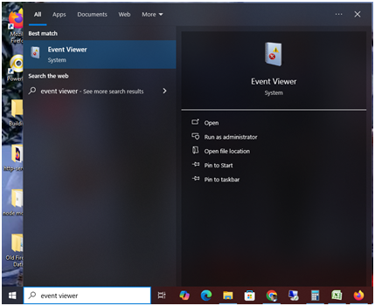
5.1.6 Event Viewer
Figure. 5.1 Launching Event Viewer
The following steps can be followed to launch the Event Viewer:
On the Windows Search box, write event viewer
A pop-up menu appears which looks like the one shown in Figure 5.1
Click on Event Viewer

Slide 19
Cont…
Events are placed in different categories as shown on the left side of Figure 5.2.
Each category is related to a log that Windows keeps on events regarding that particular category

Slide 20
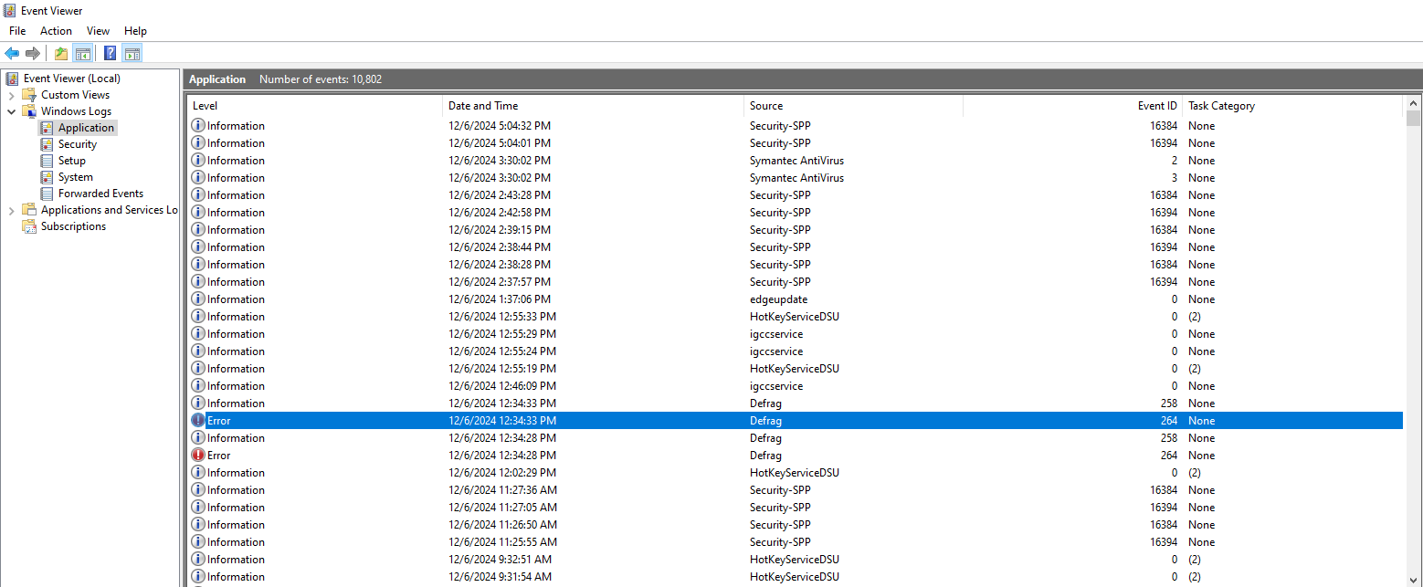
Cont…
Figure. 5.2 Event Viewer

Slide 21
Cont…
Windows Log category, which contains the following items
Application-records events related to Windows system components, such as drivers and built-in interface elements
System-records events related to programs installed on the system
Security-records events related to security, such as logon attempts and resource access

Slide 22
5.1.7 Device Manager
Device Manager is used to check the status of different hardware devices
Steps to open device manager:
Click on the Windows search box in the lower-left corner.
Type Control Panel.
Double-click the Control Panel on the Windows pop-up menu.
Click Hardware and Sound.
Under Device and Printers, Click on Device Manager (see Figure 5.3)

Slide 23
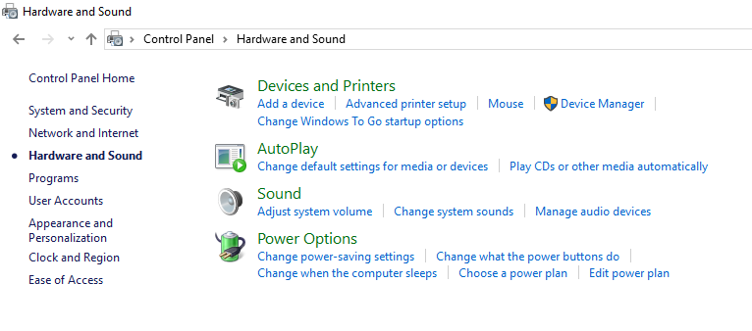
Cont…
Figure 5.3 Windows Control Panel

Slide 24
Cont…
The Device Manager has the following four benefits.
It works as a centralized utility from which all the hardware on a system can be configured.
It provides a central and organized view of all hardware- Microsoft Windows-recognized hardware- installed on a system.
It helps to manage all the hardware devices installed on a system. This includes keyboards, hard disk drives, USB devices, etc.
It helps to change hardware configuration options, manage drivers, enable or disable hardware, identify conflicts between hardware devices, etc.

Slide 25
Cont…
Indicators in Device Manager:
A yellow triangle: Indicates a device problem, such as driver issues or conflicts.
A red X: Means the device is disabled or not connected.
A downward-pointing arrow means the device has been disabled.

Slide 26
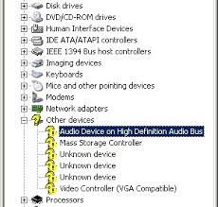
Cont…
A yellow question mark: indicates that the system does not know which driver to install for the hardware. This problem will be solved by installing the appropriate driver software for the device
Figure 5.4 Yellow question mark on device manager

Slide 27
5.1.8 Diagnostic Tools
Diagnostic Tools are software tools that are used to help troubleshoot, diagnose and solve hardware problems.
The top two diagnostic tools are :
a. Windows Performance Monitor and
b. windows resource monitor

Slide 28
Cont…
a) Windows Performance Monitor:
This tool helps track the overall performance of your computer.
It can monitor CPU usage, memory utilization, disk activity, and network performance.
(See Figure 5.5).

Slide 29
Cont…
Steps to view the Performance Monitor:
1. Press CTRL + ALT + Delete button at the same time.
2. Choose Task Manager, and the window shows that appears in Figure 5.5.
3. Then click on the Performance tab to see the performance of the CPU and other devices in the computer

Slide 30
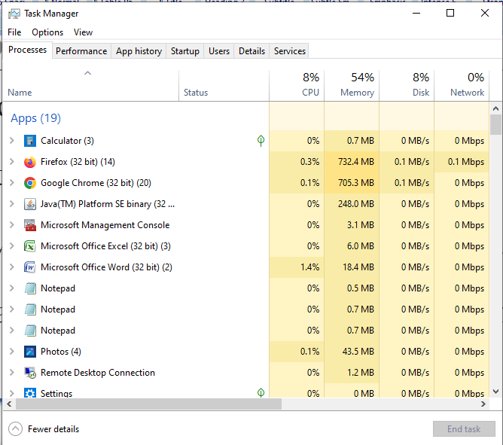
Cont…
Figure 5.5 Task Manager

Slide 31
Cont…
Notes
Way of reducing the load from the CPU:
Restart the computer to remove any unwanted temporary files
If any application shows CPU usage of almost 100%, disable the application and then start it again

Slide 32
Cont…
b) Windows Resource Monitor
This tool allows to take an in-depth look into which processes are affecting the CPU, how much memory is being used, the disk activities,
And the network information such as current TCP (Transport Control Protocol) connections, and which processes are listening on which port

Slide 33
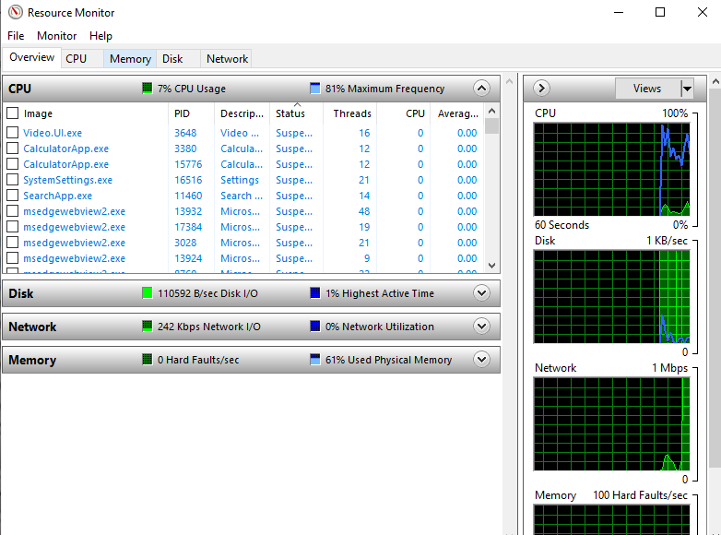
Cont…
Steps to open the Windows Resource Monitor
On the Windows search box, write Resource Monitor
Click on the Resource Monitor, and then the window shows what appears in Figure 5.6.

Slide 34
Cont…
Clicking on the CPU tab in the Windows Resource Monitor lists the four sections namely, Processes, Services, Associated Handles, and Associated Modules.
The processes that are running are shown in black color under the Processes section,
The suspended Processes are shown in blue color
The processes that are not responding are shown in red color.
Figure 5.6 Windows Resource Monitor

Slide 35
Cont…
If you find your computer slowing down unexpectedly:
Open resource monitor window
Click the CPU column
Right-click on the application that taking up a lot of CPU resources
Click on End process

Slide 36
5.2 Basics of Preventive maintenance
Preventive maintenance consists of routine actions to minimize hardware failures and maintain optimal system performance.
Regular maintenance ensures the longevity and efficient functioning of hardware components.
Activities Include:
Regular diagnostics to catch issues early.
Cleaning the system to prevent dust accumulation and overheating.

Slide 37

5.2.1 Preventive maintenance for Dust
Cleaning Methods:
Cloth: Use microfiber cloths to wipe down the exterior of devices.
Chemical Cleaners: Use safe screen cleaners for displays and monitors.
Vacuuming: Regularly vacuum dust from cooling fans and inside the system to prevent overheating.

Slide 38
5.2.2 Antivirus Software
A computer virus is a type of computer program that(when executed) replicates itself by modifying other computer programs and inserting its own code.
Antivirus, which is also known as anti-malware, is a computer program used to prevent, detect and remove malware.

Slide 39
Cont…
To download and install antivirus:
Search the antivirus software, for example, on Google
Then click on the search result on the name of the Antivirus software you want to download
You can directly install from the Internet or save the antivirus software on your hard disk
If it is saved on the hard disk, install the antivirus software

Slide 40
Cont…
Scanning computer systems regularly with antivirus software help prevent the computer system from virus infection.

Slide 41
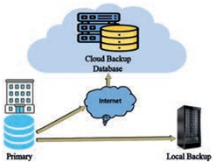
5.2.3 Backups
Backup is a process of transferring data or files from a computer system to external storage devices or on a cloud storage server
The backup file is used to recover data loss during computer failure
Figure 5.7 Data backup

Slide 42
Cont…
Steps to take back up
Open the Control Panel
Choose Backup and Restore
Choose Set up back-up
The window will be displayed as shown in Figure 5.10.
Click on Create a system image,
Select the storage drive either a hard disk, DVD disk, or a Network drive where you intend to store your backup.
Then click on the next button, and
Finally click on the start backup button

Slide 43
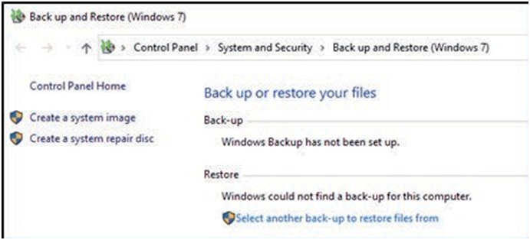
Cont…
Figure 5.8 Disk Backup Window
Note:
Backup is the first step before any troubleshooting on a computer system is done.

Slide 44
5.2.4 Scan Hard Disk
When old files are deleted from the hard disk and new files are saved, the files become fragmented.
Fragmentation is the scattering of portions of files in the disk in nonadjacent areas, thus greatly slowing access to the files
When a hard disk is new, the operating system puts files on the disk contiguously (next to one another)
When a file is updated over time, new data for that file is distributed to unused spaces.
It, therefore, takes the operating system longer to read these fragmented files

Slide 45
Cont…
A defragmenter utility program, commonly called a “defragger,” finds all the scattered files on the hard disk and reorganizes them into the smallest number of adjoining regions
In other words, defragmentation is a process that reduces the degree of fragmentation.
This increases the computer’s speed

Slide 46
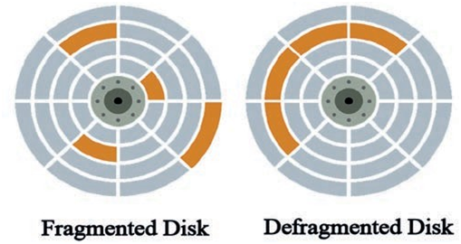
Cont…
Figure 5.9 Disk Defragmentation

Slide 47
Cont…
Steps to undertake disk defragmentation:
Type Windows Administrative Tools on the Windows search box and click on Windows Administrative Tools.
Double-click on Defragment and Optimize Drives.
Then the window shown in Figure 5.12 will be displayed.
Select the drive, and then click on the Optimize button.

Slide 48
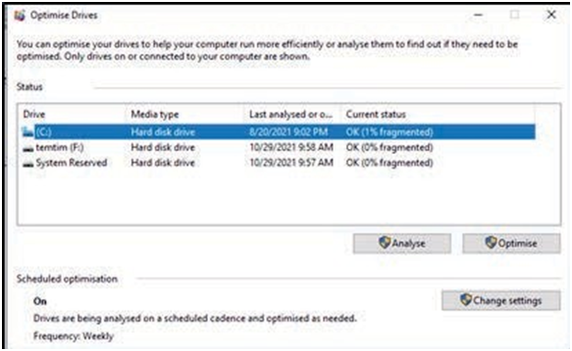
Cont…
As shown in this Figure , if the drive’s current status says (0% fragmented), there is no need to do defragmentation
Figure 5.10 Disk Optimization Window

Slide 49
5.2.5 Power Protection Devices
The following tools are used as a means to prevent potential damages that can be caused by electric powers
Surge Protectors: Protect devices from voltage spikes that can damage electronic components.
Voltage Regulators: Help maintain consistent voltage levels, preventing fluctuations that could damage hardware.
UPS (Uninterruptible Power Supply): Provides backup power during outages, allowing users to save their work and properly shut down the system.

Slide 50
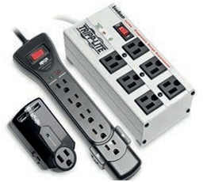
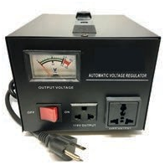
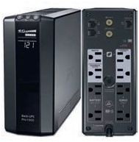
Cont…
Power surge protectors
Power voltage regulator
UPS power surge

Slide 51
5.2.6 Shut Down Properly
Properly shutting down the computer ensures that the system saves all data and minimizes the risk of hardware damage.
It helps in maintaining the longevity of hardware by allowing safe system shutdown.

